Slide 1
Buying in to a good school?
The link between house cost and school ratings
Sam Azhari, Gregory Brown, & Kim Sommer

Slide 2

Finding a house = finding a school
When you’re shopping for a house, you don’t just consider the four walls you’ll be purchasing. In effect, you’re buying into an entire community and everything that comes with it– including the schools.
Through personal experience, we agreed that you have to spend more money on a house if you want your kids go to a higher-rated school. But could we prove that personal experience with the data? Is there actually a correlation between property value in a ZIP code and the quality of the schools in that same area?

Slide 3

Our questions
What is the correlation between the average property value in an area and the school rating in that area?
Are there any other factors that may influence property value or school rating?
Does the percentage of economically disadvantaged students in a school population correlate with school rating?
Does the impact of crime on property values reflect onto school ratings?

Slide 4
Data exploration and cleanup
Jupyter notebook

Slide 5

Data sources
Florida Department of Education: http://www.fldoe.org/accountability/accountability-reporting/school-grades/ (Florida Department of Education)
Google Places API
Property Value Assessment Data: ftp://sdrftp03.dor.state.fl.us/Tax%20Roll%20Data%20Files/2020%20Final%20NAL%20-%20SDF%20Files/
Hillsborough County Sheriff’s Office : https://gis.hcso.tampa.fl.us/publicgis/crimemapping/

Slide 6
Data visualization
Plots and maps

Slide 7
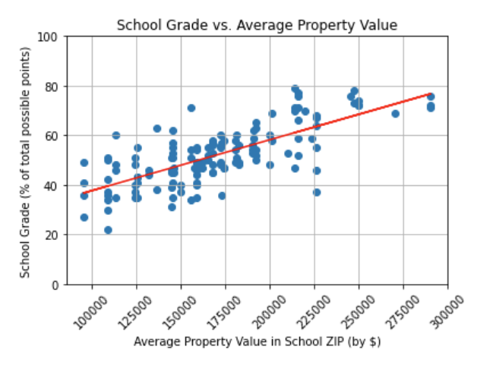
Property value vs. school rating
The r- value for this graph is 0.54 (rounded)
This r- value is enough to reject the null hypothesis that property value and school rating bear no correlation.
As the average property value in a ZIP code increases, so does the school rating, showing that higher-rated schools are found in higher-priced ZIP codes.

Slide 8
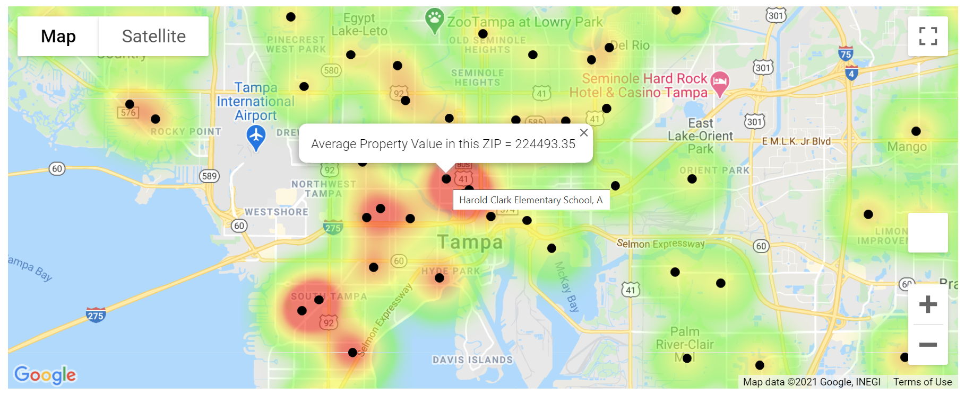
Property value heatmap
This interactive map shows school locations (black dots) on a heat layer depicting average property value of an area.
Hovering over the black dot symbols reveals school name and grade. Clicking on the symbol shows average property value of that ZIP.
Map enables exploration of schools in an area and provides information on a per-school basis.

Slide 9
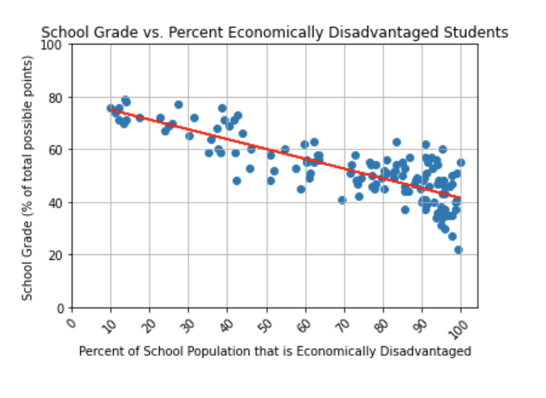
Percent economically disadvantaged students vs. school rating
The percent of economically disadvantaged students represents the percentage of a school’s population that is made up of students who qualify for free or reduced lunch.
The r- value for this graph is 0.67 (rounded)
This r- value is enough to reject the null hypothesis that the percentage of economically disadvantaged students in a school and school rating bear no correlation.
As the percentage of economically disadvantage students increases, school rating decreases, i.e., a school with a high percentage of economically disadvantaged students is less likely to have a high rating.

Slide 10
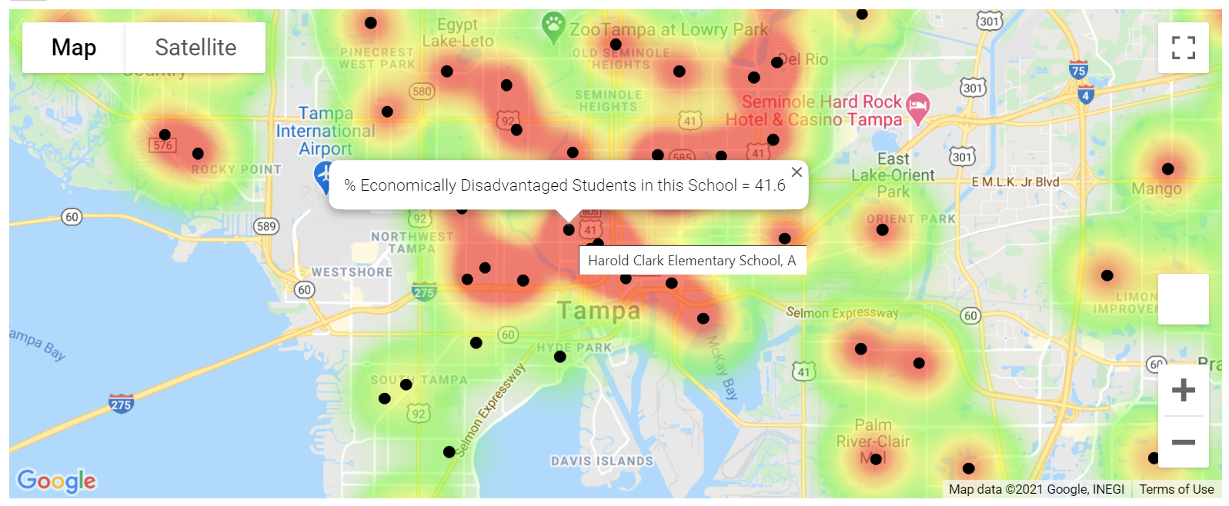
heatmap of Schools with high Percentage of economically disadvantaged students
This interactive map shows school locations (black dots) on a heat layer depicting % of economically disadvantaged students of schools.
Hovering over the black dot symbols reveals school name and grade. Clicking on the symbol shows percentage of economically disadvantaged students in that school.
The heat layer colors highlight the locations of schools with higher percentages of economically disadvantaged students.

Slide 11
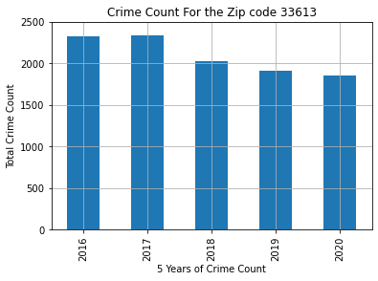
CRIME STATS OVER THE PERIOD OF 5 YEARS of zip code 33613
This graph is to show the sum of crimes that had occurred in targeted zip codes over the period of 5 years.
A clear trend could be established that crimes had been on the decline
.

Slide 12
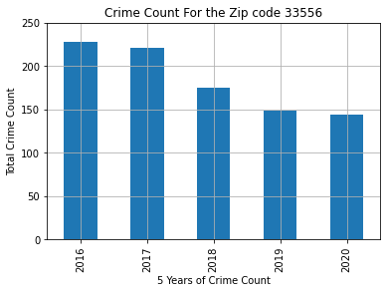
CRIME STATS OVER THE PERIOD OF 5 YEARS of zip code 33556
This graph is to show the sum of crimes that had occurred in targeted zip codes over the period of 5 years.
A clear trend could be established that crimes had been on the decline
.

Slide 13
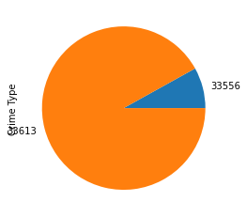
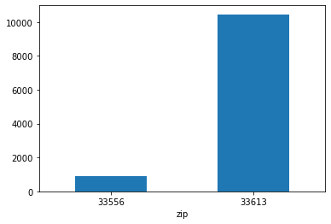
COMPARISON OF CRIMES COUNT BETWEEN BOTH ZIP CODES (33613 & 33556)
This graph is A Comparison of the count of crimes committed in each of the zip codes in target,
A clear difference in the count of crimes between each of these two Zip Codes

Slide 14
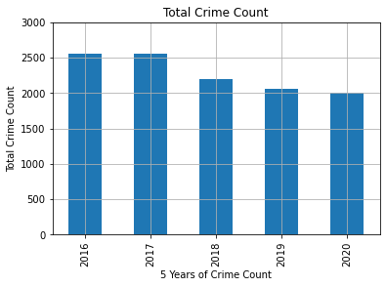
How crimes are trending in the last 5 years?
Another observation we have noticed that could also be a direct effect of property values, and the continuous increase of the average property values in the Hillsborough county in general and in our areas of target. Is that in this graph, there’s an obvious decrease in crimes over the time period we have looke into.

Slide 15
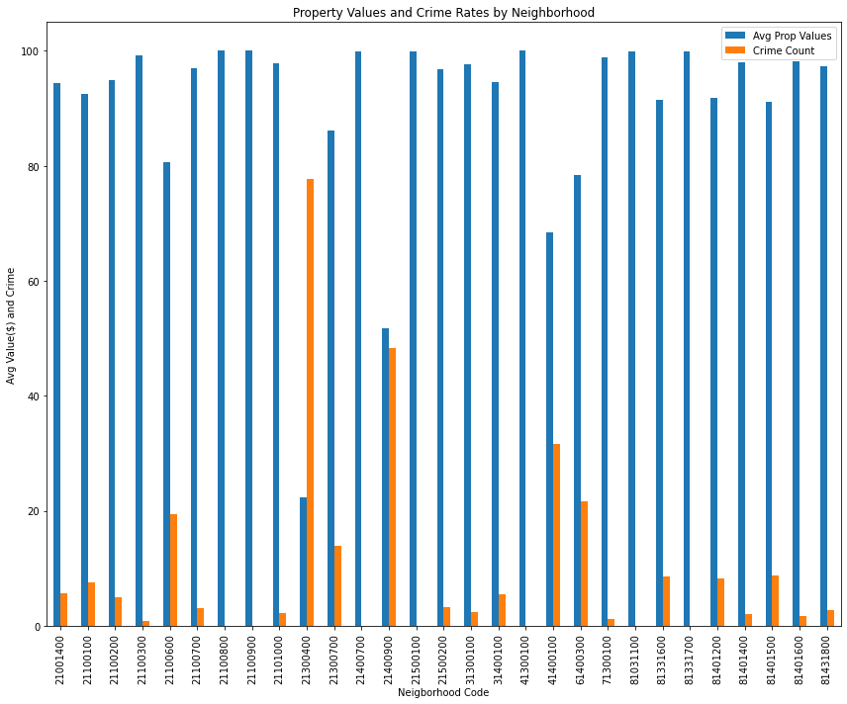
Property value vs. crime count
This graph shows the impact of crime on property values by neighborhood code.
It’s evident that in neighborhoods with low crime count have higher property values than those with high crime counts.
.

Slide 16
Implications of the data
What this means in the real world

